Slide 1


Hello, CI!
INDIA
FEB 23, 2021
Notes:
https://kb.epam.com/display/ETSTCC/North+America+Automation+Mentoring+Programm

Slide 2
AGENDA
1
CI and CD concept
2
Benefits and limitations
3
CI environment
4
Jenkins install & configure
5
Jobs and triggers
6
Artifacts and distributed builds

Slide 3
CONTINUOUS INTEGRATION
Continuous Integration is the practice of testing each change done to your codebase automatically and as early as possible.
Continuous Deployment follows the testing that happens during Continuous Integration and pushes changes to a staging or production system. This makes sure a version of your code is always accessible.

Slide 4
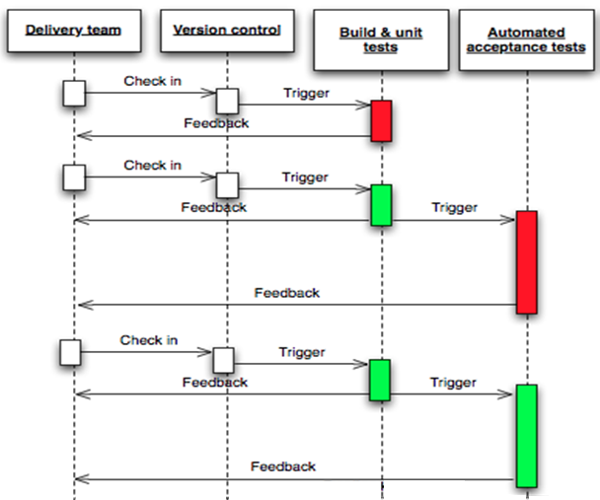
CONTINUOUS INTEGRATION
Version control
Build automation
Test automation
Often commits
Built on change

Slide 5

CI BENEFITS
Code is automatically built > no broken builds
Application is automatically deployed > ready for manual and automation test
Bugs are early discovered and fixed
Running tests on demand, by schedule, post-commit
Running tests on dedicated machines with proper preconditions
Regular and often tests execution gives quick automation ROI
Built-in parallel execution

Slide 6

CI LIMITATIONS
Need to set up and support infrastructure
Need to regularly analyze test results (ignoring CI results gives zero automation value)
Continuous Delivery is great but won’t work with my project.”
There are indeed some cases when CI/CD may not be suitable.
Your customers don’t want continuous updates to their systems.
Regulations restrict how software can be updated. For example, continuously updating software used in aerospace, telecom, and medical industries is not an option.

Slide 7













CI ENVIRONMENT
CI Tool
Build Tool
VCS

Slide 8
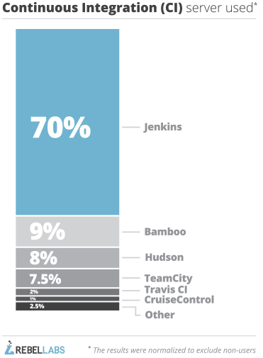

JENKINS
An extendable open source continuous integration server
Why Jenkins?
Free and open source
Large number of plugins (1300+)
Cross-platform
Big community
Everyone else has it (eBay, Facebook, GitHub, LinkedIn, Yahoo! …)
https://wiki.jenkins-ci.org/pages/viewpage.action?pageId=53608972
Notes:
http://jenkins-ci.org/

Slide 9
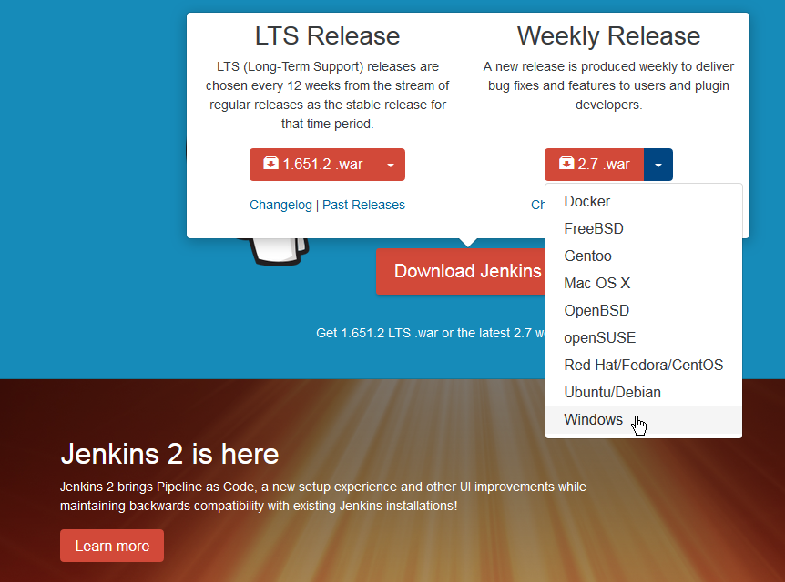
DOWNLOADING JENKINS
jenkins.io
Jenkins now requires Java 7

Slide 10
JENKINS DEMO

Slide 11
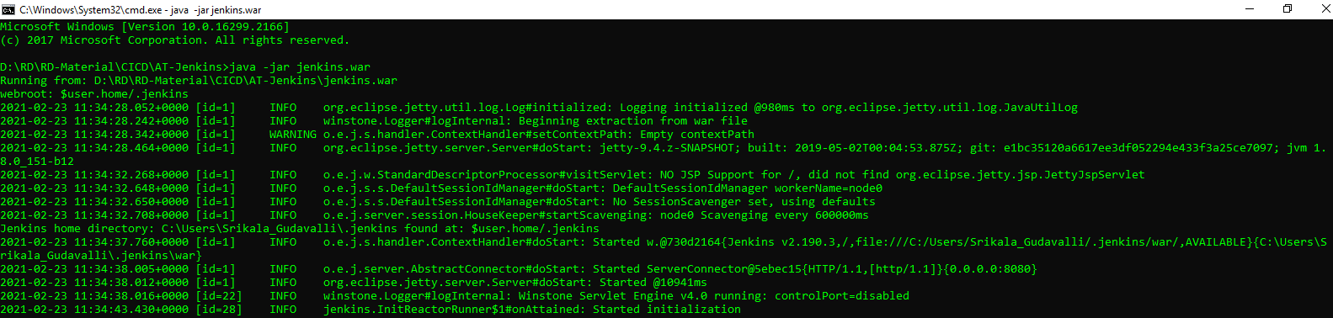
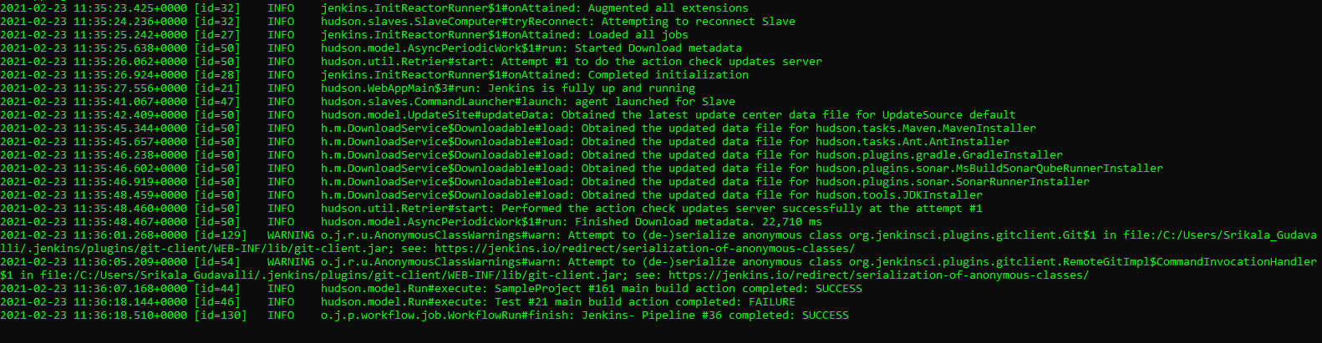
RUN JENKINS

Slide 12
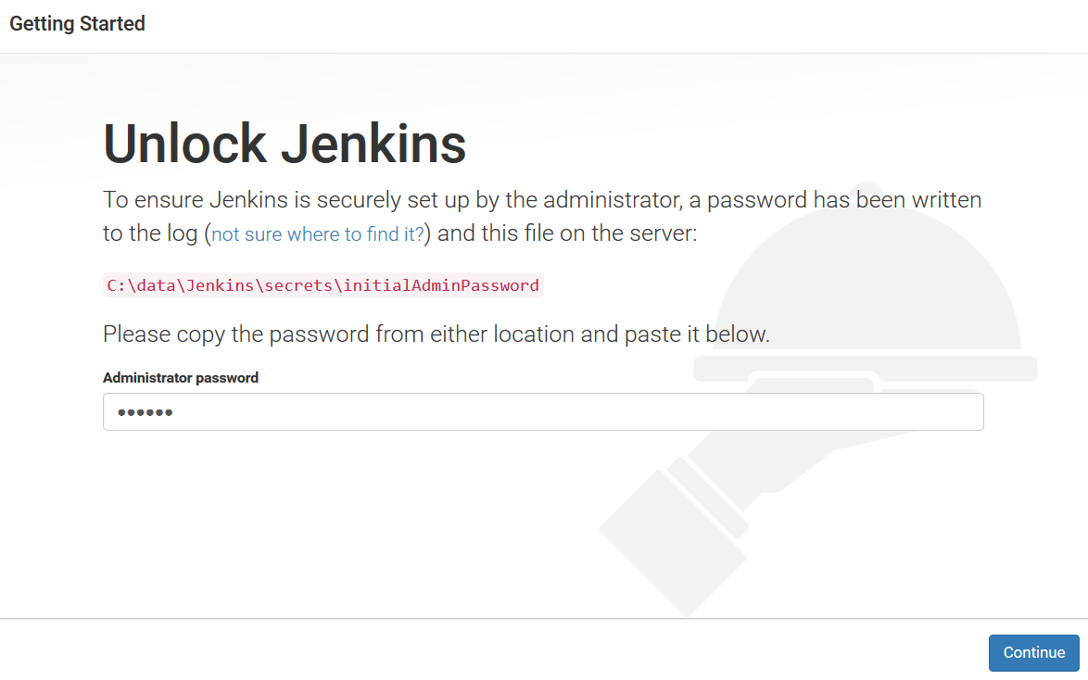
FIRST RUN
https://jenkins.io/2.0/

Slide 13
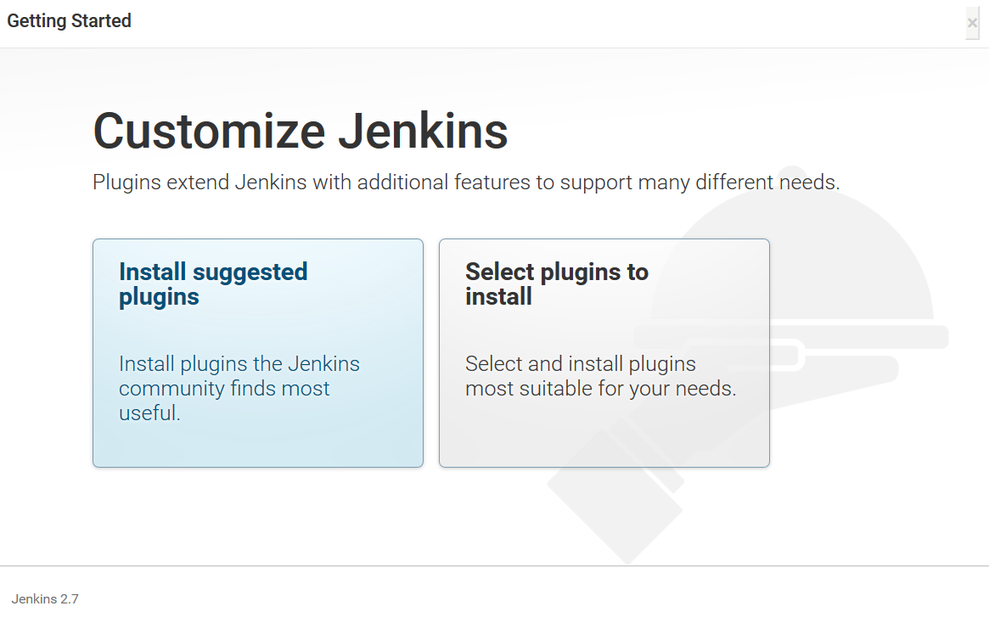
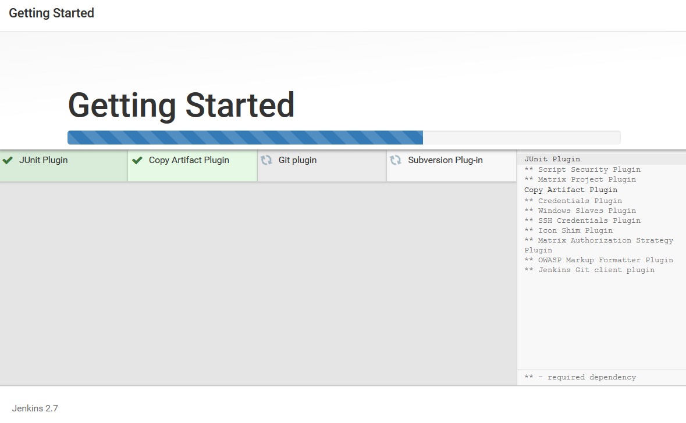
SELECT PLUGINS
Junit
CopyArtifact
Git plugin
Subversion plugin
Windows slaves plugin
Mailer plugin

Slide 14
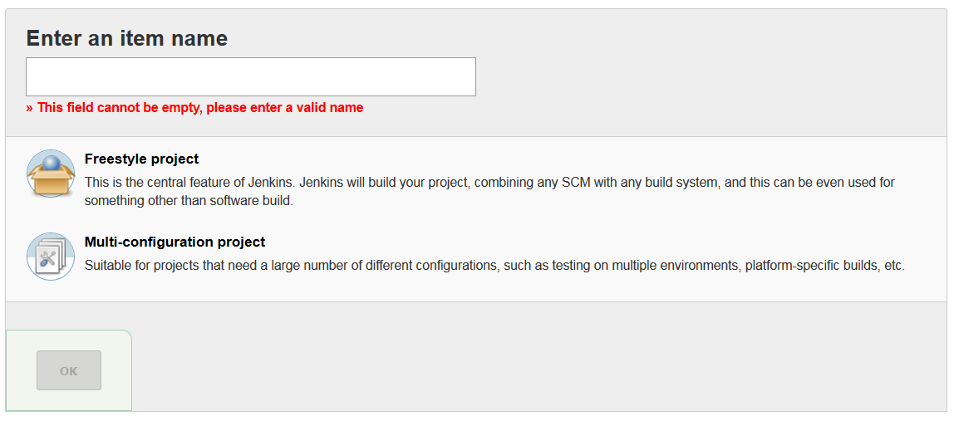
JOBS

Slide 15
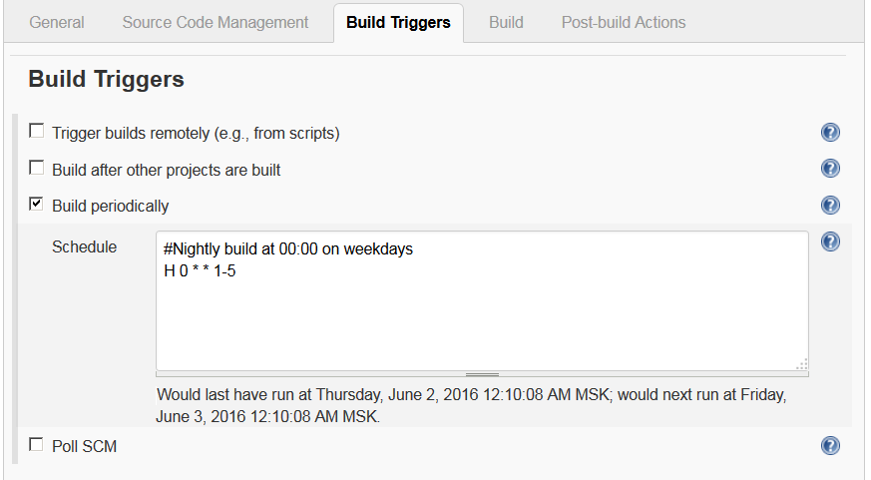
BUILD TRIGGERS
Most common:
Cron schedule
SCM check
On-demand run

Slide 16

CRON SYNTAX
# * * * * * command to execute
# ┬ ┬ ┬ ┬ ┬
# │ │ │ │ │
# │ │ │ │ │
# │ │ │ │ └───── day of week (0 - 7) 6=Saturday 0,7=Sunday
# │ │ │ └────────── month (1 - 12)
# │ │ └─────────────── day of month (1 - 31)
# │ └──────────────────── hour (0 - 23)
# └───────────────────────── min (0 - 59)
*/5 * * * * - every 5 minutes
0 */2 * * mon-fri - every two hours at the top of the hour Monday through Friday
0 0 1,10,15 * * – midnight on 1st ,10th & 15th of month

Slide 17

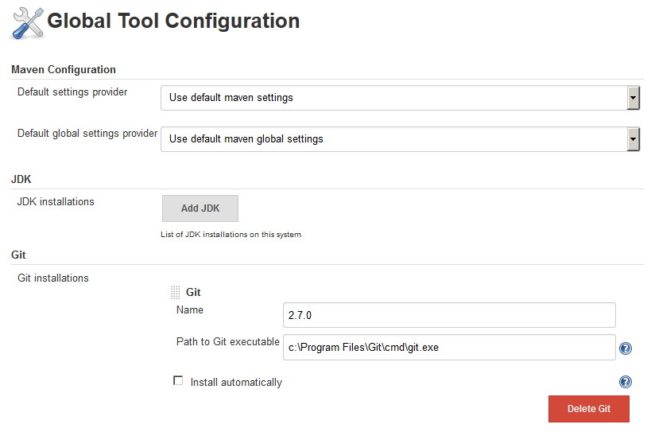
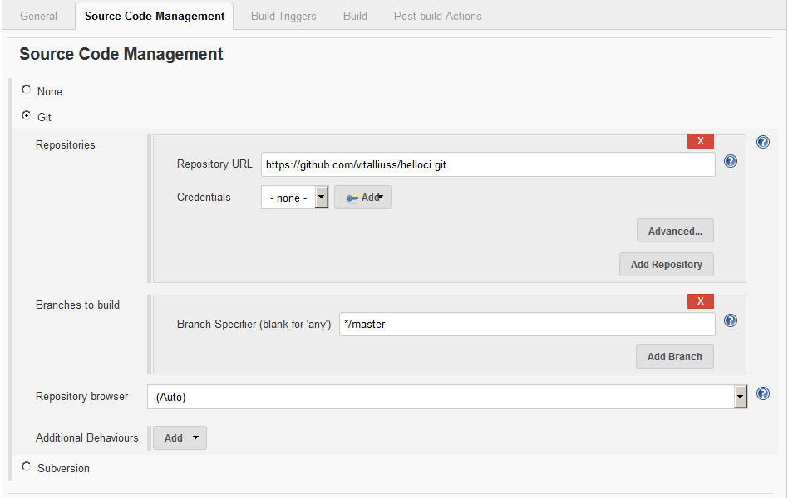
GIT INTEGRATION
Install Git plugin
Let Jenkins know where is Git installed (%GIT_HOME%\cmd\git.exe)

Slide 18
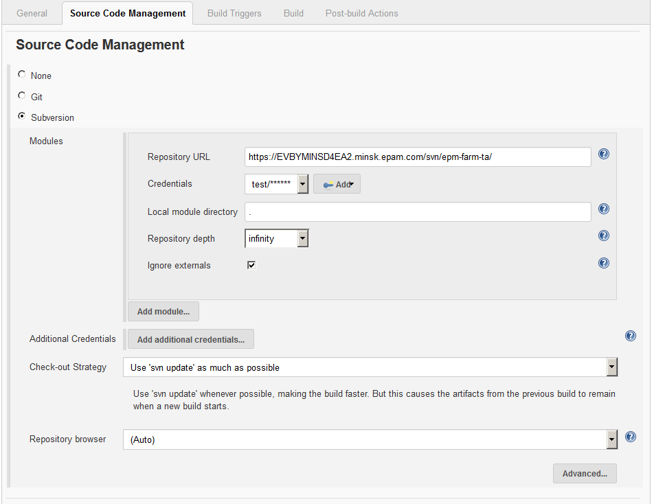

SVN INTEGRATION
For EPAM SVN enable SSL v3 protocol
Run Jenkins the same user as SVN
* -Dsvnkit.http.sslProtocols=“SSLv3”

Slide 19
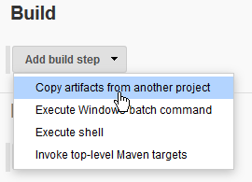
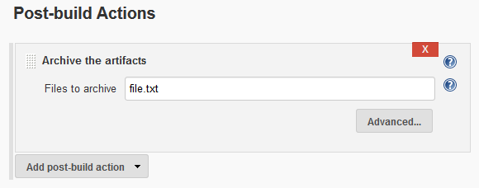
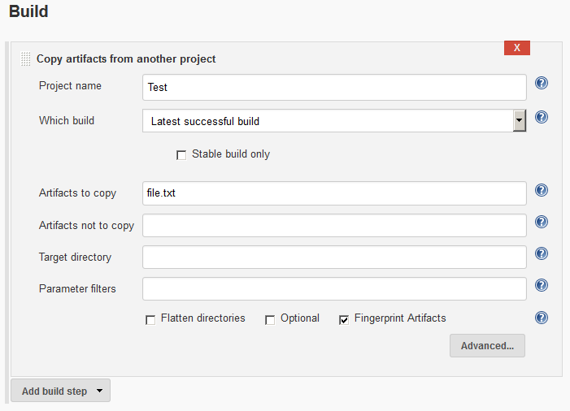
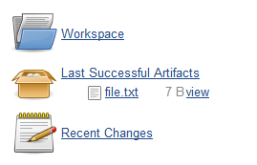
ARTIFACTS
An artifact can be any result of your build process. Use them to avoid files duplication.
3. Use artifacts in related projects
1. Archive them after the build is finished
2. See them published

Slide 20
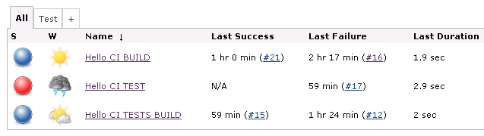
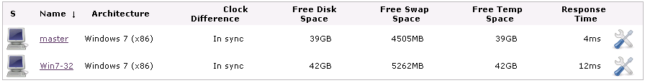
NODES
Jobs execute real work
Jobs are supposed to:
Compile Dev/Test project
Run Unit tests
Deploy application
Run tests against deployed application
etc.
Nodes are machines where work is executed

Slide 21
RUNNING AHEAD
CI Tool
Build Tool
VCS

Slide 22
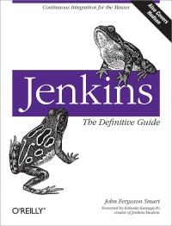
Q&A
Thank you!
• For coming today
• For asking question
Further reading:
Jenkins: Jenkins: The Definitive Guide

